Slide 1
ZONER
Harry Hoa Huynh
5/2021

Slide 2
GOAL: To Develop an IoT Eco System
Features:
Connect multiple networks of sensors
Monitor sensor data
Notification/Alert/Feedback actions via actuators
Key Characteristics:
Easy to use
High data rate
Reliable
Low cost
Scalable

Slide 3
Presentation Agenda
High Level Design
Hardware Design
Software Design
Data Collecting and Processing Design
Alert System Design
Demo
Feedback and Concern
Acknowledgement and Reference
Conclusion

Slide 4
HIGH-LEVEL DESIGN

Slide 5
HIGH-LEVEL ARCHITECTURE
Client Layer
Control Layer
Feedback Layer
Sensor Network #1
AWS
Sensor#1
WIFI
Dashboard Monitor
Sensor#2
WIFI
Microcontroller
Design Option#1
Sensor#n
Alert System
Actuator System
Sensor Network #2
WIFI
Microcontroller
Local Control Hub
WIFI
Sensor Network #n
Design Option#2
There are 2 design options:
Data is pushed directly to Cloud, where it will be stored, processed, and monitored.
Data is uploaded, processed, and monitor at a local Control Hub.
For the scope of this project ‘ZoNer’: a system is used to monitor environmental parameters around a specific space such an office or small room.
Notes:
Split up to 3 different layers
Client layers: Multiple networks of sensors/ multiple transmitter such as WIFI MCU
Control layers
Feedback

Slide 6
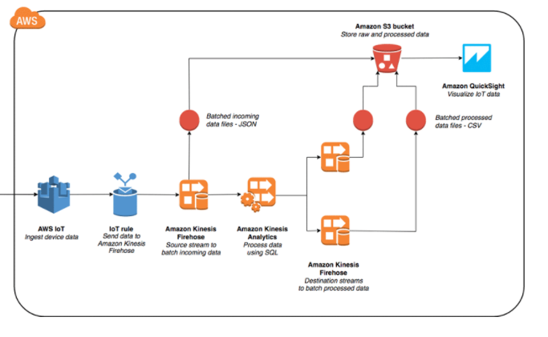
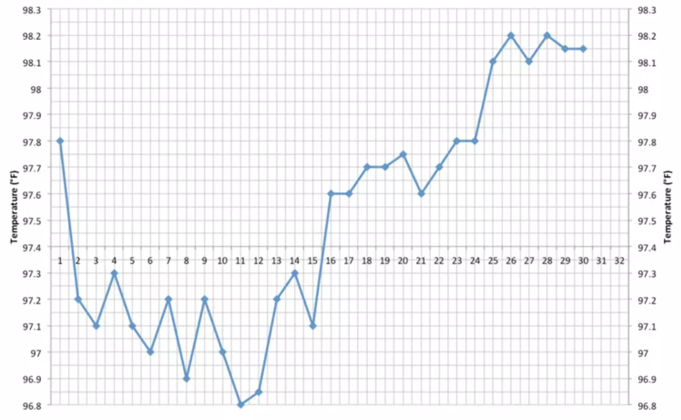
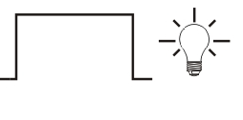


DESIGN OPTION#1: BLOCK DIAGRAM
Dashboard Control
Sensor Network #1
On Cloud
Actuator System
Sensor Network #2
MQTT
Via WIFI
MQTT
Alert System
Via WIFI
Sensor Network #n
Via Wireless

Slide 7

TERMINATE DESIGN OPTION #1
Early experiment shows significant daily cost with an average of $5 to use simple min/max functions on single sensor data set.
Cost mainly is around these services:
AWS Key Management Service
Amazon Kinesis
Amazon Kinesis Analytics
After unsuccessful discussion with AWS and hours searching ways to activate Educate Starter Account or to earn AWS credit, there’s no choice but to move to Option#2 to maintain low service cost.

Slide 8
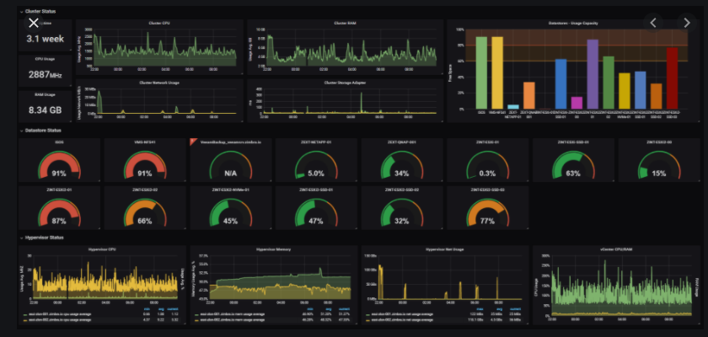
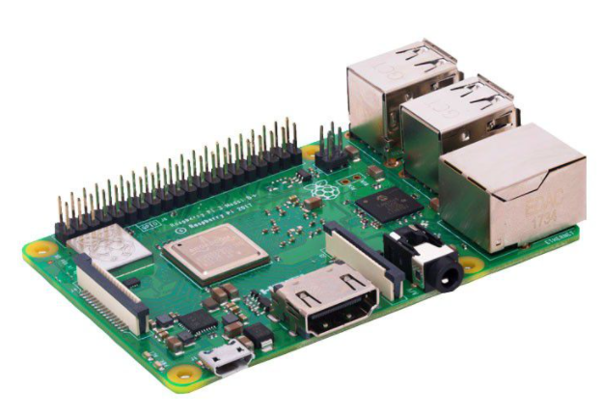


DESIGN OPTION#2: INITIAL BLOCK DIAGRAM
Sensor Network #1
MQTT
Dashboard Control
Via Localhost
Sensor Network #2
MQTT
Via WIFI
Alert System
Via Wireless
Sensor Network #n
MQTT/Wired
Actuator System

Slide 9

Design Option#2 is a good solution:
Open-source environment -> NO COST to LOW LOST
Scale up on your own will with also NO COST to LOW COST

Slide 10
HARDWARE DESIGN

Slide 11
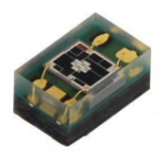
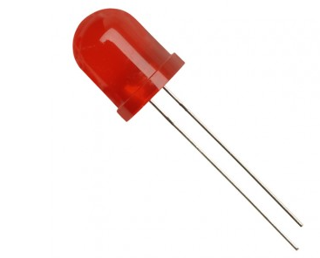
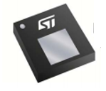
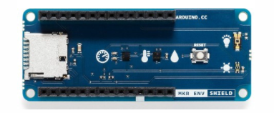
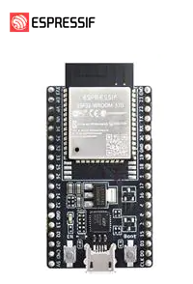
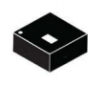
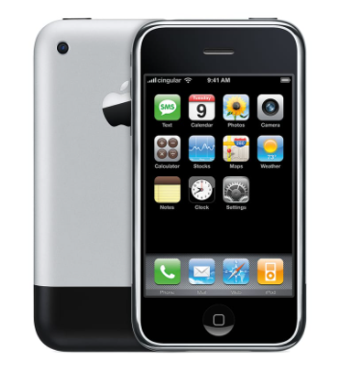
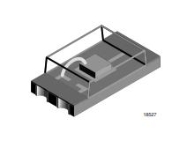
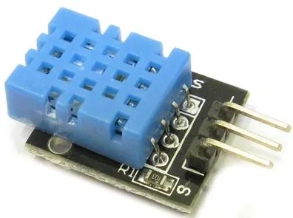

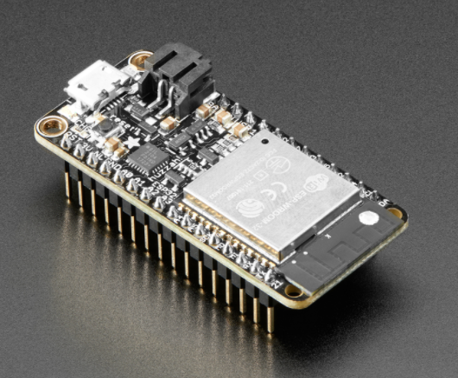
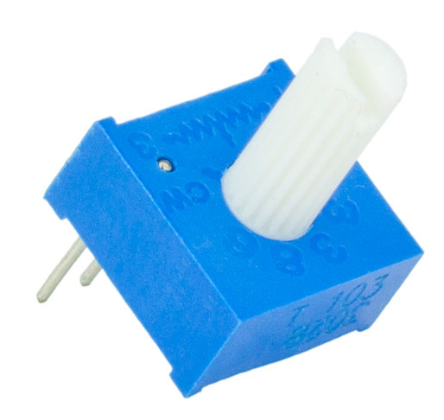
AVAILABLE HARDWARE
Client Layer
Control Layer
Feedback Layer
Environmental sensors Module
UV Sensor
VEML6075
Pressure sensor
ST LPS22HB
LEDs
ESP32-DevKitC-32D:
BLE/Wifi
Low cost
Rasp Berry Pi 3
Temperature
& Humidity
ST HTS221
iPhone
Ambient Light
Sensor
TEMT6000
Temperature& Humidity
DHT11
ESP32 Feather:
BLE/WIFI
Low cost
Desktop
10k Potentiometer

Slide 12


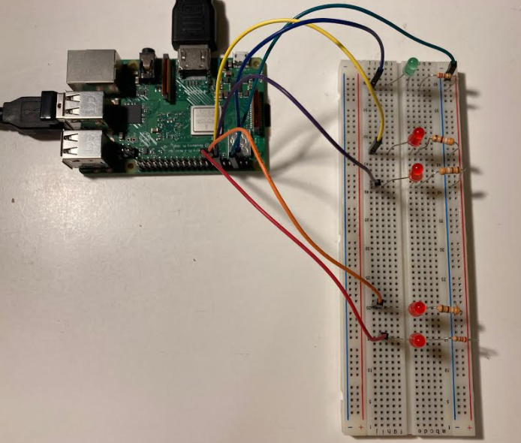
FINAL BLOCK DIAGRAM
Client Layer
Control Layer
Feedback Layer
MQTT
I2C/Analog
Via Localhost
Network of sensor #1
Via wires
MQTT
Via WIFI
Zone#01
IFTTT & Webhook
Via Wireless
1-Wire
MQTT
Via wires
Via WIFI
Network of sensor #2
Analog
Via Wires
Via wires
Zone#01
Notes:
Explain on Potentiometer
IFTTT offers many services:
*Phone/Email/HTTP/MQTT, etc.

Slide 13
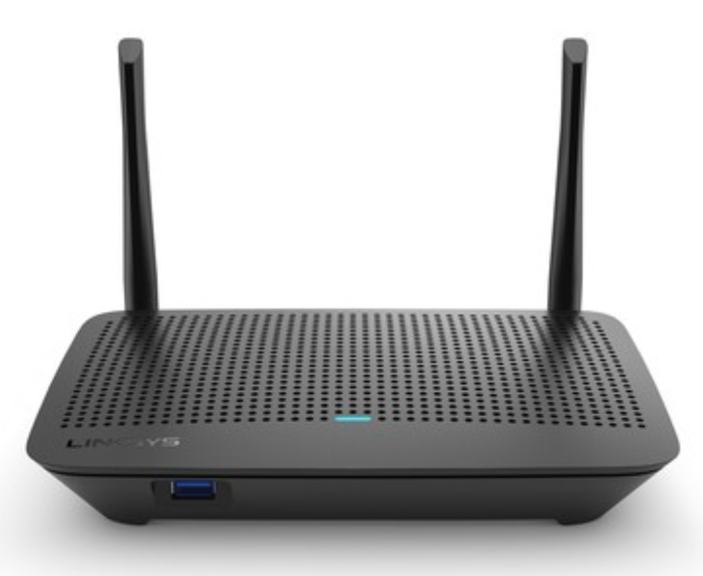

WIRING DIAGRAM
Wi-Fi Router shall be within 50 meters of the sensor network and PI
#VCC
3.3V
J2:#1
GND
GND
J3#1
#12:SCL
SCL
J3:IO22
#11:SDA
SDA
J3:IO21
A2
Analog
J3:IO33
J3:IO3
USB Power
GPIO3
Debugging LED
GPIO 3,11, 12
Zone#1 Alert/Actuator
For Network of Sensors#1
Data
1-wire
IO33
GPIO 13, 15
Zone#2 Alert/Actuator
For Network of Sensors #2
GND
3.3V
GND
Analog
USB Power
USB Power
Sensor Network can be located at any interested space within 50 meter of Wi-Fi router
Pi can be located at any interested space within 50 meter of Wi-Fi router

Slide 14
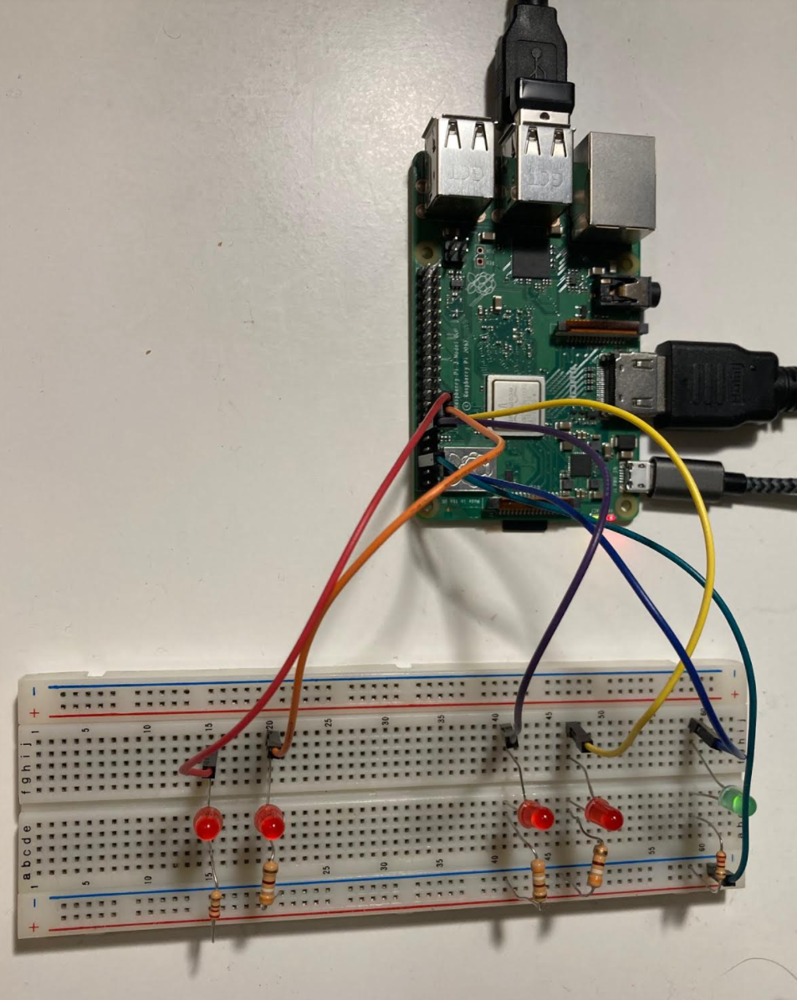
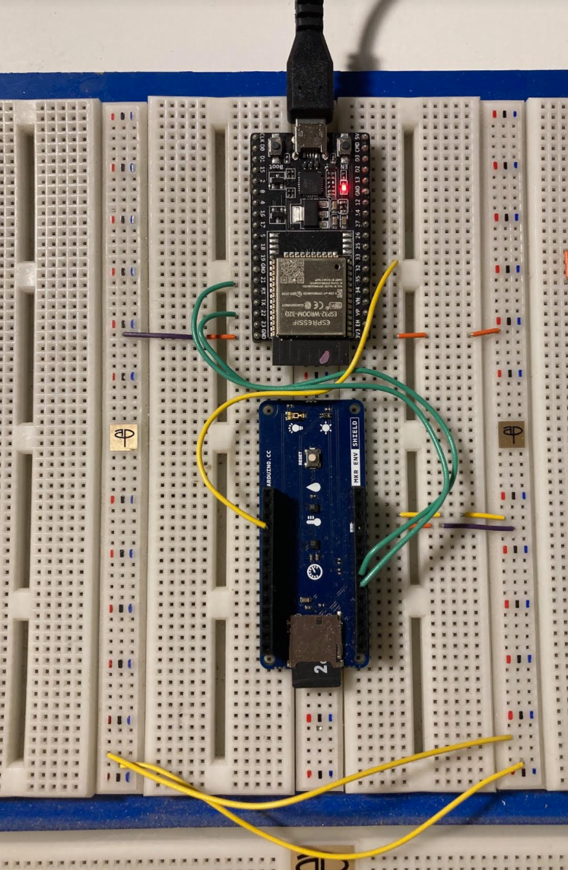
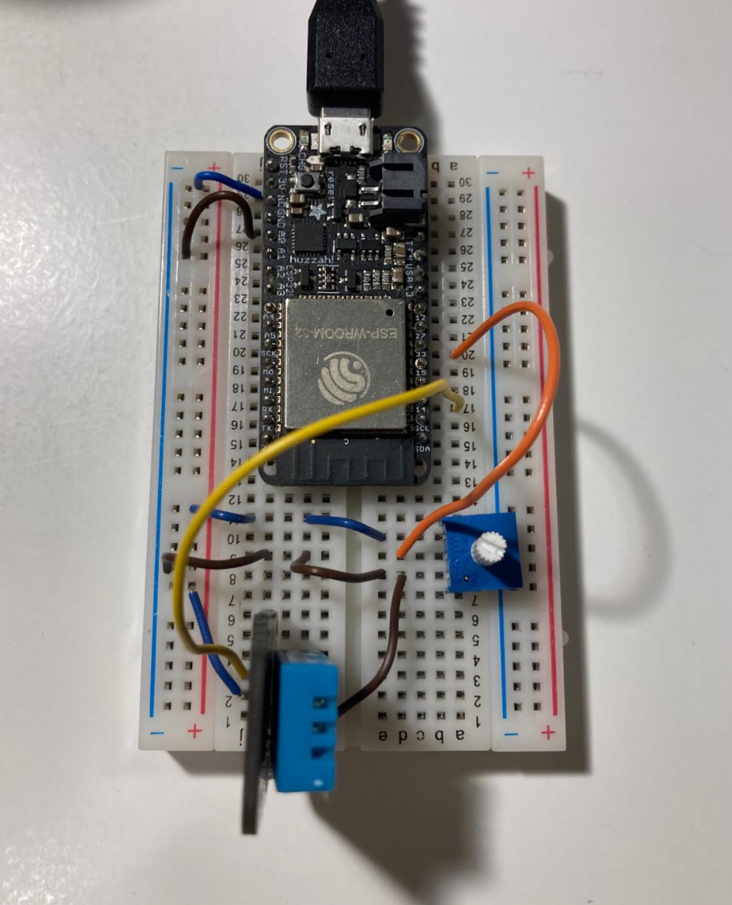
WIRING DIAGRAM
Network of sensor #1
Network of sensor #2
Control Hub with Alert Indicator/Actuator
LED#1 (Green): Blinking LED indicating PY working
LED#2: Zone01 Alert for Temperature
LED#3: Zone01 Alert for Lux
LED#4: Zone02 Alter for Temperature
LED#5: Zone02 Alert for Pot. Voltage

Slide 15

SENSOR SPECS
Network of Sensors # 1 |  |  |  |  | Network Sensor #2
 | LPS22HB | TEMT6000 | VEML6075 | ST HTS221 | DHT11 | Potentiometer functioned as a test sensor
Functionality | Atmospheric pressure | Ambient lux | UV A/B | Temperature and Humidity | Temperature and Humidity | Voltage
Input Voltage (V) | 3.3 | 3.3 | 3.3 | 3.3 | 3.3 | 3.3
Min Current on-time(uA) | 3 | 0.003 | 0.8 | 0.5 |  | 0
Typical Current on-time (uA) | 12 | 50 | 480 | 2 | 2.5 | 150
Max Current on-time(uA) | 12 | 750 | 480 | 2 |  | 330
Data output | 1. 24-bit pressure data 2. 16-bit temperature data | 1. 12-bit data lux from ESP32 ADC | 1. 16-bit UVA data 2. 16-bit UVB data | 1. 16-bit temperature data 2. 16-bit humidity data | 8-bit data | 1. 12-bit data voltage from ESP32 ADC
Min Power consumption (mW) | 0.0099 | 0.0000099 | 0.00264 | 0.00165
Typical Power consumption (mW) | 0.0396 | 0.165 | 1.584 | 0.0066 | 0.00825 | 0.495
Max Power consumption (mW) | 0.0396 | 2.475 | 1.584 | 0.0066
Communication Protocol | I2C | Analog | I2C | I2C | Single wire | Analog
Expected size of package per transmission (bit) | 40 | 12 | 32 | 32 | 8 | 12
Datasheet | LPS22HB | TEMT6000 | VEML6075 | HTS221 | DHT11

Slide 16
POWER BUDGET ON SENSOR NETWORK
ESP32
Wifi chip | ESP32­
Input Voltage (V) | 3.3
Min active transmitting Current (mA) | NA
Typical active transmitting Current (mA) | 240
Max active transmitting Current (mA) | NA
Modem sleep (mA) | 68
Light-sleep (mA) | 0.8
Deep sleep (uA) | 150
Hibernation (uA) | 5
Min Transmission Power (mW) | NA
Typical Transmission Power (mW) | 792
Max Transmission Power (mW) | NA
Deep Sleep Power (mW) | 0.495
Communication Protocol | Wifi
Datasheet | ESP32­WROOM­32D
Network of Sensor #1: ESP32 Power + All Sensors
Typical Power Consumption per transmission (mW) | 793.7952
Minimum Power during Hibernation (mW) | 0.5049
Package size per transmission (bit) | 116
Expected number of transmission per day | 2880
Network of Sensor #2: ESP32 Power + All Sensors
Typical Power Consumption per transmission (mW) | 793.50325
Minimum Power during Hibernation (mW) | 0.99825
Package size per transmission (bit) | 28
Expected number of transmission per day | 2880
Notice that power of network sensor is high though it transmits less sensor data, majority of power consumption goes through the Potentiometer (which is a voltage divider between 3.3V and GND)

Slide 17
SAVE POWER METHODS
Publish data every 30 seconds from ESP32
Disconnect WIFI and MQTT clients every 30 seconds, and only re-establish WIFI and MQTT connection before publishing data
EPS32 + Sensor Network stays in the Deep Sleep Mode, and only wake up every 30 seconds to capture and send data, then go back to the Deep Sleep mode
Future action: reduce size of package (size of raw data) to speed up the transmission and reduce power for future scale up

Slide 18
SOFTWARE DESIGN

Slide 19
DATA FLOW
Client Layer
Control Layer
Feedback Layer
Wires
Send alerts to Actuator/Indicator (LEDs)
Collect Sensor Data
Every 30s
Process Data in PI
Send Sensor Data to PI
IFTTT & Webhooks
Send alerts to Phone
MQTT
Subscribe Data to all topics
Display to Dashboard
Every 30s
Save Subscribed Data to Influx DB
Monitor Data using Grafana GUI
Alert Notifications to Email
ESP32
PI
Wire
Wireless
Notes:
Key: Publish data every 30 seconds.

Slide 20
DATA
Network of Sensor #1
MQTT Package | #1 | #2 | #3 | #4 | #5 | #6
Type/topic | Pressure | Temperature | Humidity | Lux | UVA | UVB
Raw Data (bit) | 24-bit | 16-bit | 16-bit | 12-bit | 16-bit | 16-bit
Network of Sensor #2
MQTT Package | #1 | #2 | #3
Type/topic | Temperature | Humidity | Voltage
Raw data (bit) | 8-bit | 8-bit | 12-bit
Total raw data per transmission: 116 bits (network#1) and 28 bits (network#2)
Total number of transmission per day: 2880 times (once every 30 seconds))
Total number of raw data transmitted per day: 334,080 bits (network #1) and 80,640 bits (network#2)

Slide 21
Development Tools/Service
Visual Studio with PlatformIO:
To program/debug ESP32 modules
Develop in C
Python
Develop in Python scripts for Pi data collection and data analytic
Debugging in Py
IFTTT Service
Wireless Notification
Webhook Service
Wireless Notification
MQTT Service
Data Collection
Grafana Service
Dashboard and wireless notification
InfluxDB Service
Data Collection

Slide 22
MQTT VS HTTP
Why MQTT (Message Queuing Telemetry Transport):
Data centric (vs. document centric)
Light weight with short message header
Minimal message length : 2 bytes
Maximal message length: 265 bytes
93 time faster than HTTP (using 3G networks)

Slide 23

ESP32 – PI COMMUNICATION: MQTT
MQTT Broker
Mosquitto
Publish all the topics
Publisher
Every 30s
Subscriber
Influxdb Database
Subscribe to all the topics
Network#1 Publishing with location “Zone#01”:
“Humidity” via Humidity Topic
“Temperature” via Temperature Topic
“Pressure” via Pressure Topic
“UVA” via UVA Topic
“UVB” via UVB Topic
“UV Index” via UV Index Topic
“Lux” via Ambient Light Topic
Network#1 Publishing with location “Zone#02”:
“Pot Voltage” via Pot_Voltage Topic
“Temperature” via Temperature Topic
“Humidity via Humidity Topic
Notice that: 2 networks have the same topic name, but their locations are different.
Notes:
Explain the same topic, but different location

Slide 24
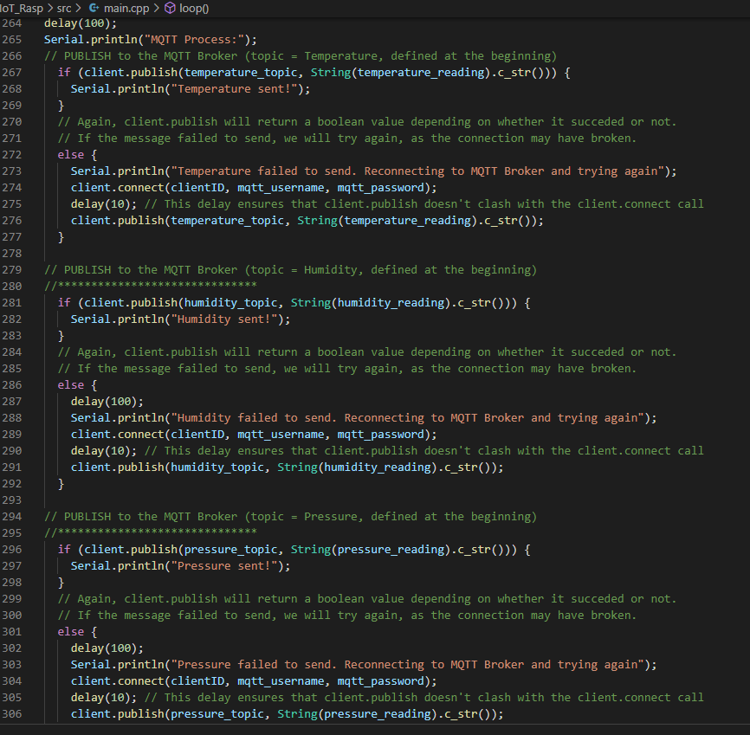
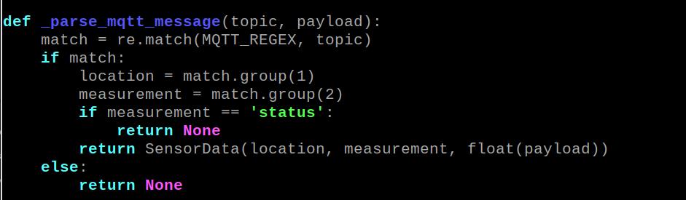
MQTT@EP32/Zone01
MQTT@PI

Slide 25
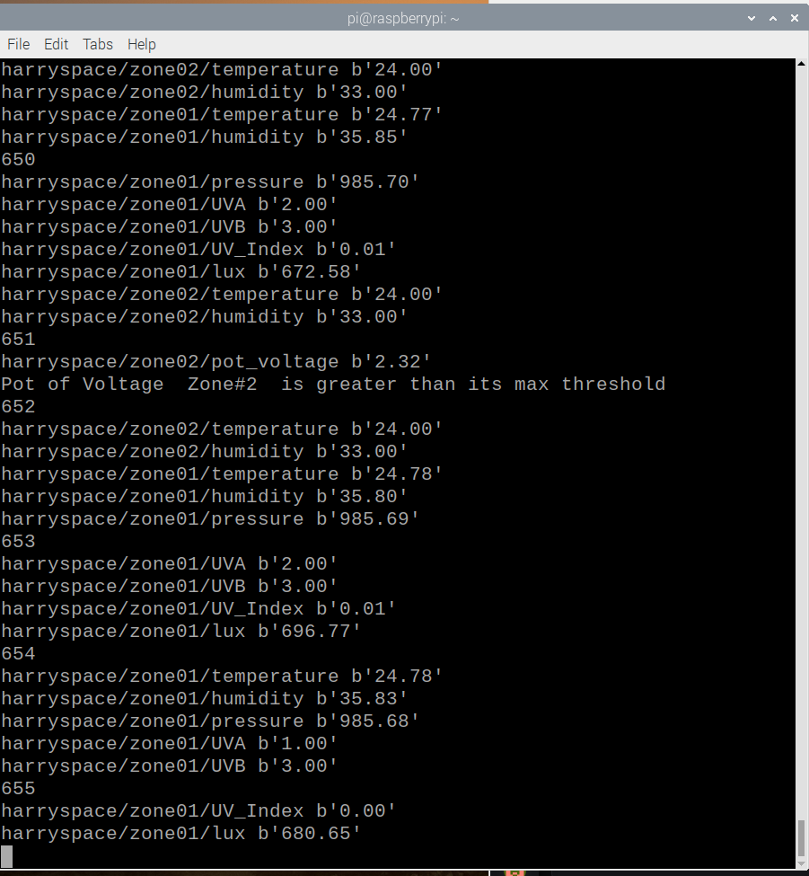
MQTT Debugging
The log shows debugging message generated by Python script on Raspberry Pi.
Integer number: debugging counter, increase by 1 every time mqtt_client.loop_start() is called.
Data from 2 networks of sensors (Zone01 and Zone02)
Alert via debugging window on pot_voltage of Zone 02

Slide 26
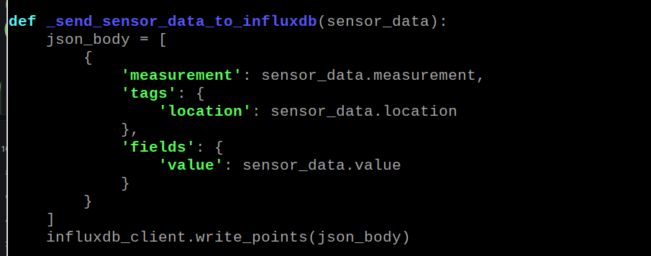
InfluxDB@PI
Data is separated in 3 domains:
Type of measurement
Location
Data value
Notes:
Json body

Slide 27
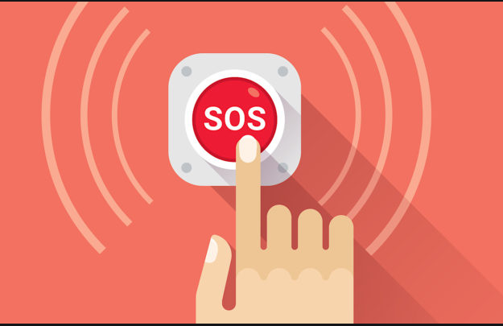
Alert/Notification/Actuator

Slide 28
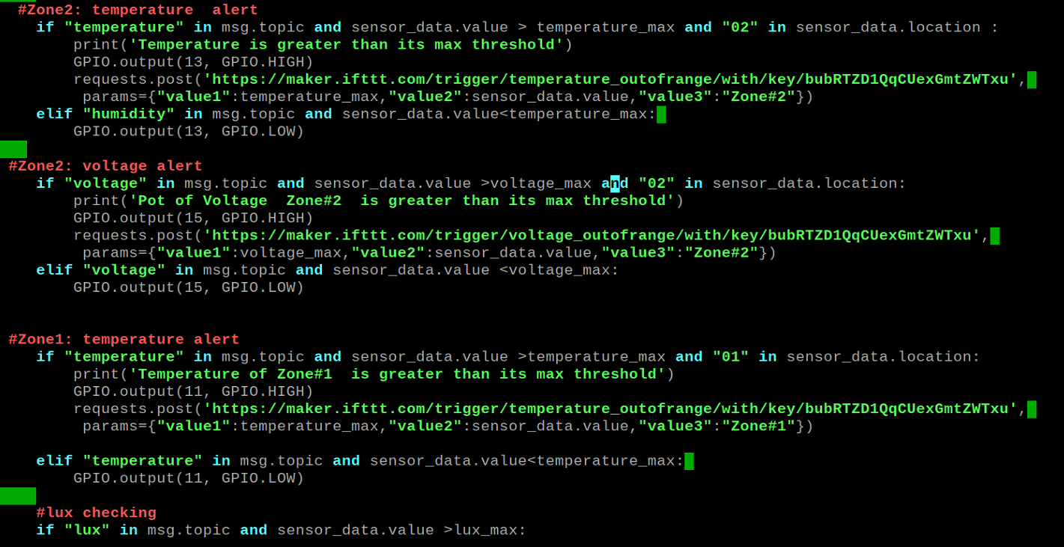
IFTTT Alert from Pi
Conditions
LED Alert
IFTTT Alert with Webhooks

Slide 29
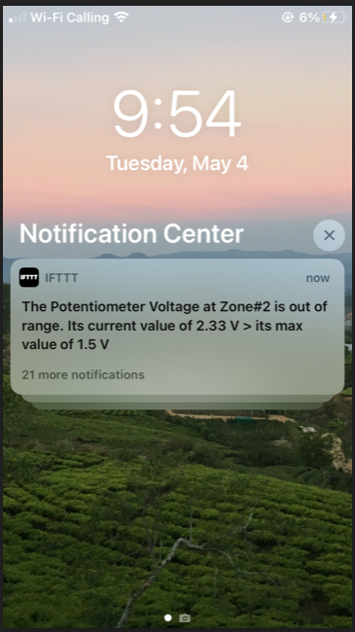
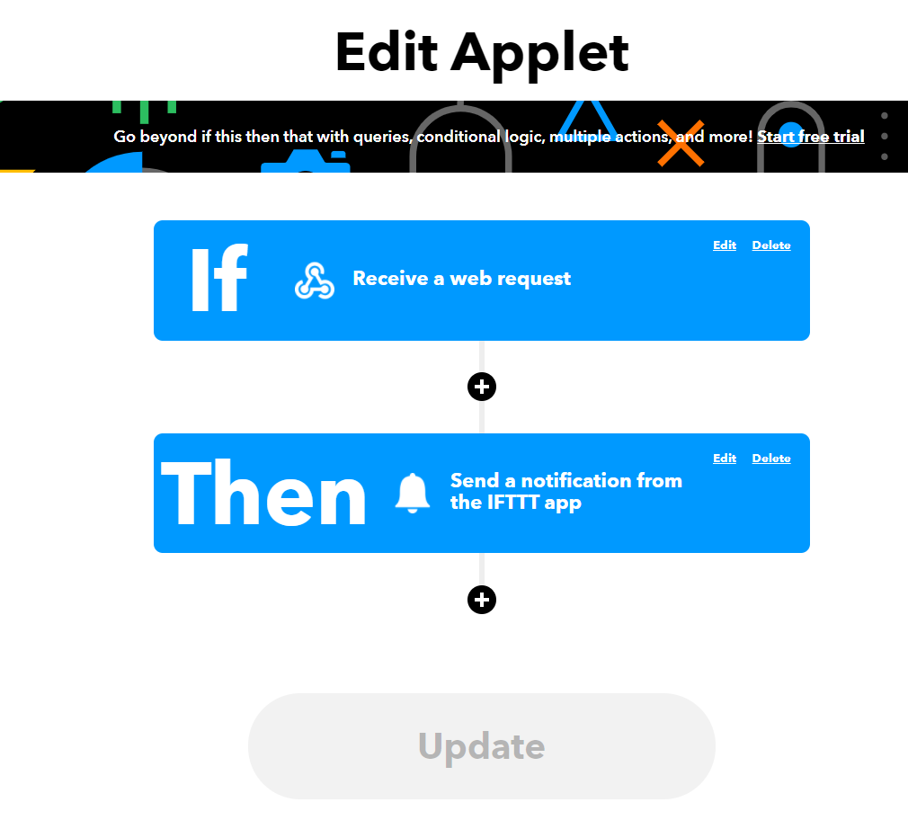
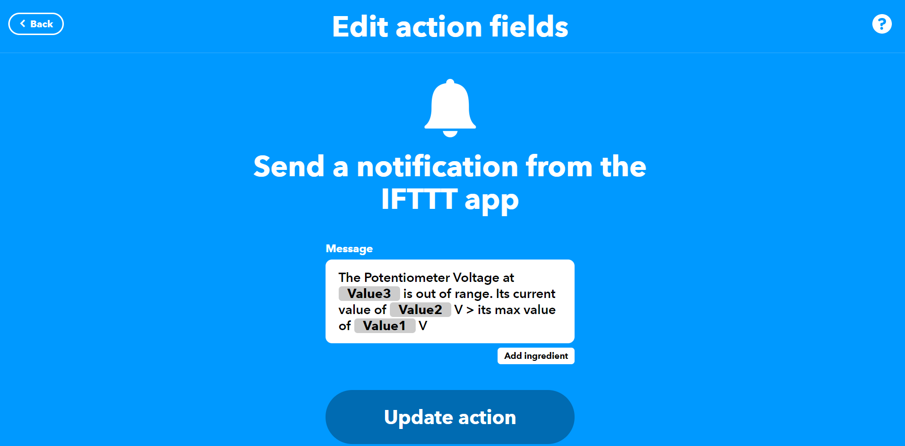
IFTTT Alter on Phone
Alert/Notification: flow from Control Hub to IFTTT Server to Phone

Slide 30
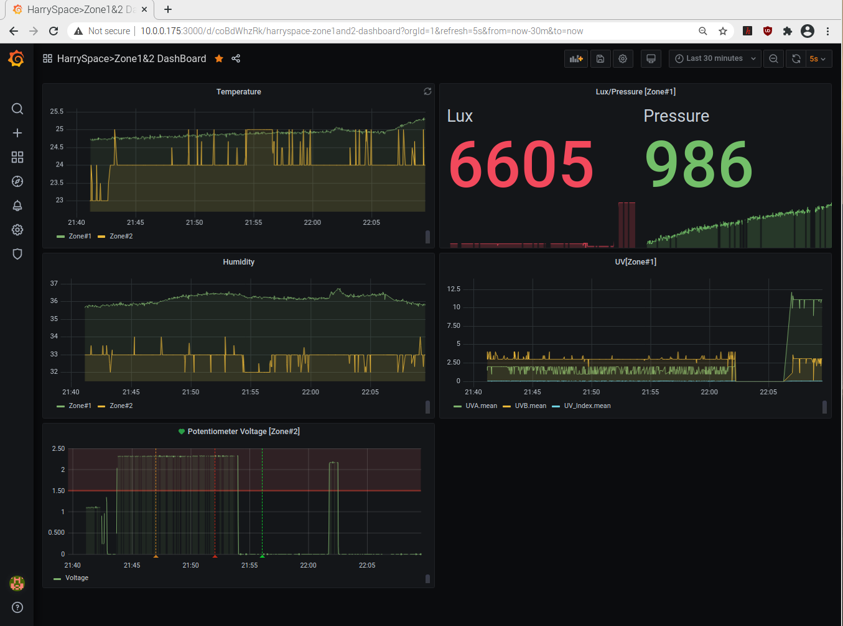
Alert on Dashboard
Alert text
Alert bar
Notes:
Lux or any data can be used for Home Protection

Slide 31
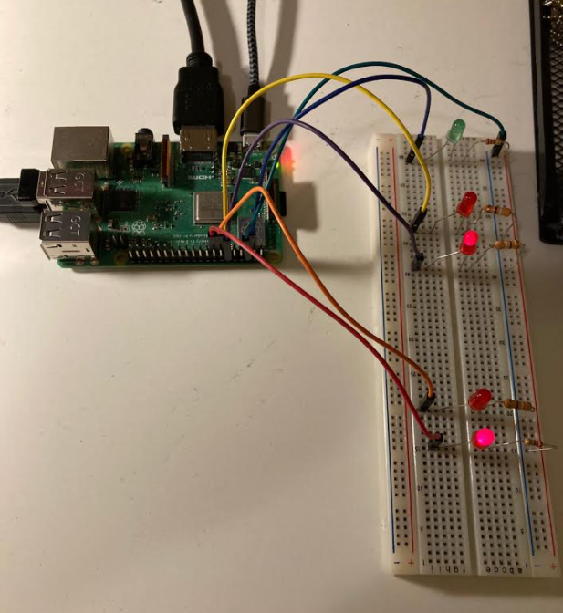
Alert on Control Hub
Blinking Debugging Indicator to verify if the Python code is functional
Zone 1: Temperature Alert
Zone 1: Lux Alert
Zone 2: Temperature Alert
Zone 2: Voltage Alert

Slide 32
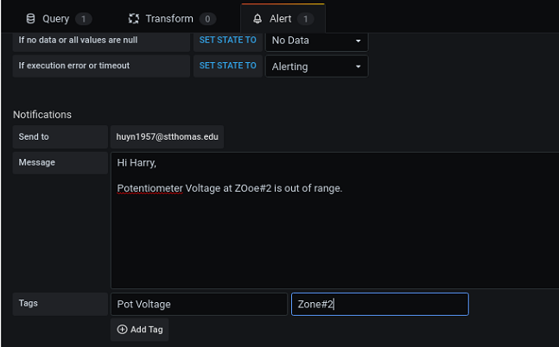
Email Notification from Grafana

Slide 33
ZoNer DEMO

Slide 34
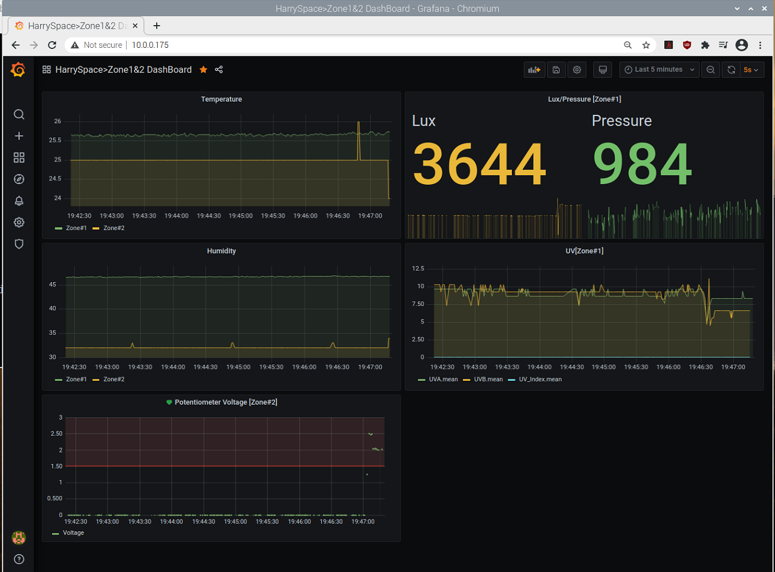
Dashboard Monitor- Working Great

Slide 35
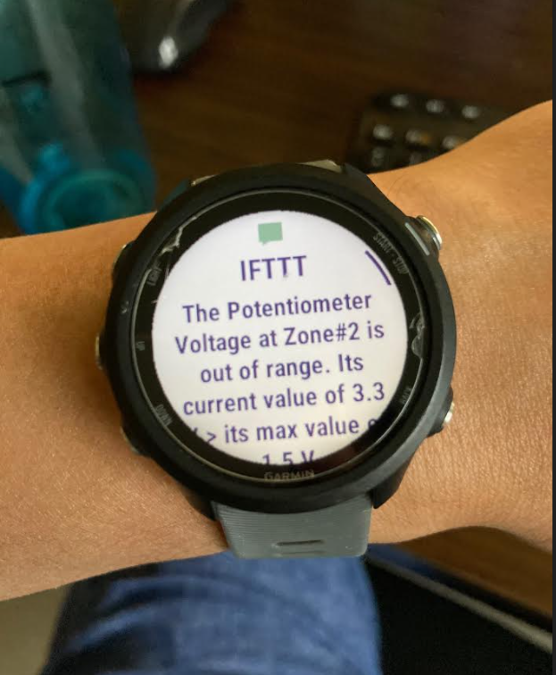
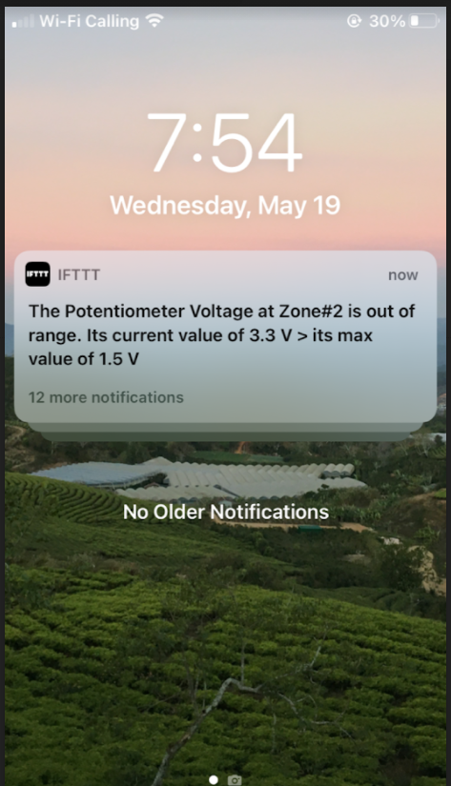
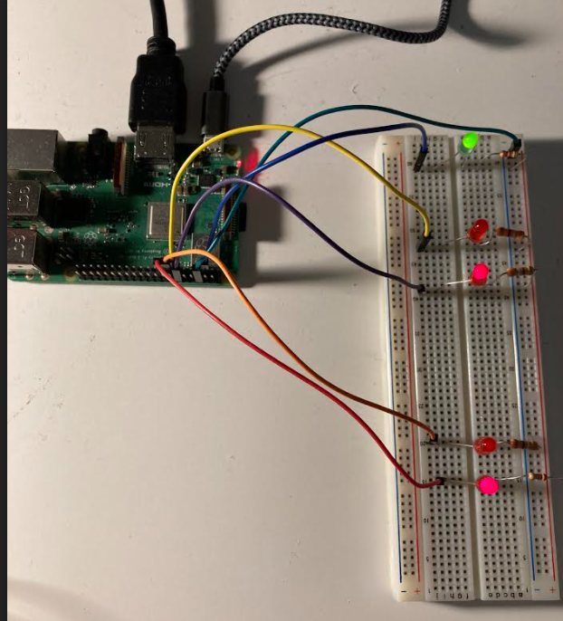
Alert System: Working Great

Slide 36
Conclusion
ZoNer is a solid foundation for future IoT applications. It offers many great features that make it a great building blocks for many IoT application in the field of data monitoring. 5 key characteristics: easy to use, high data rate, reliable, low cost, and easy to scale up are met in the ZoNer.
Future Improvement:
Power budget
Increasing the number of sensors for testing
Optimizing the code
Developing Printed Circuit Board
Designing housing
Optimizing the whole design.
It has been a great journey, and future ZoNer is hopeful to be on the market one day in the near future!

Slide 37


